Slide 4
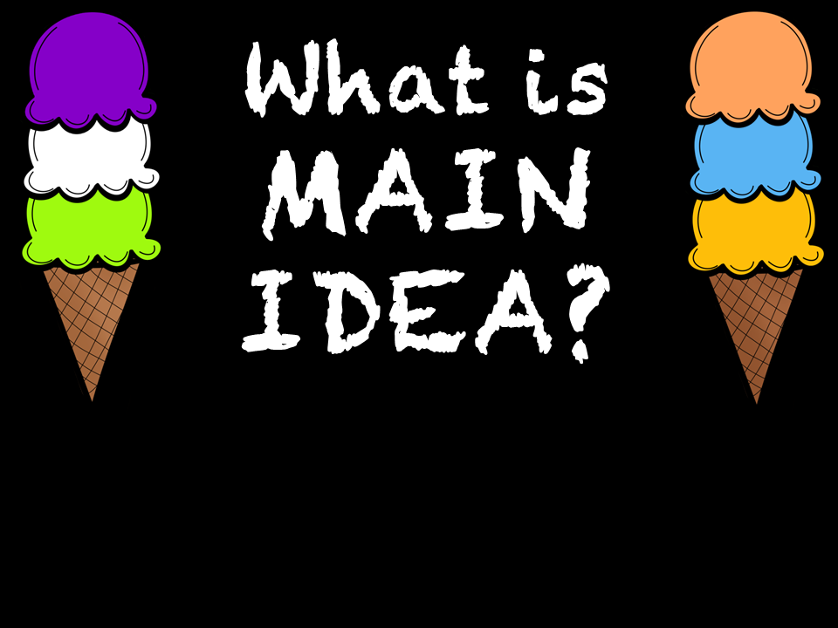

Slide 6
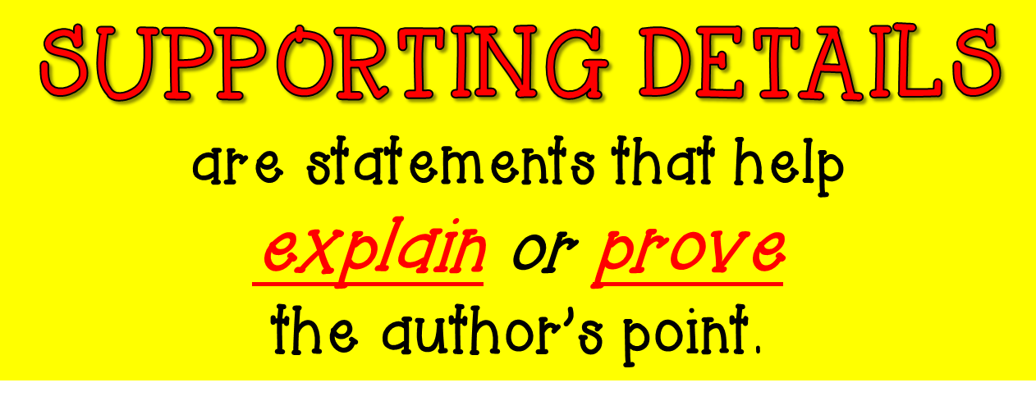

Slide 9
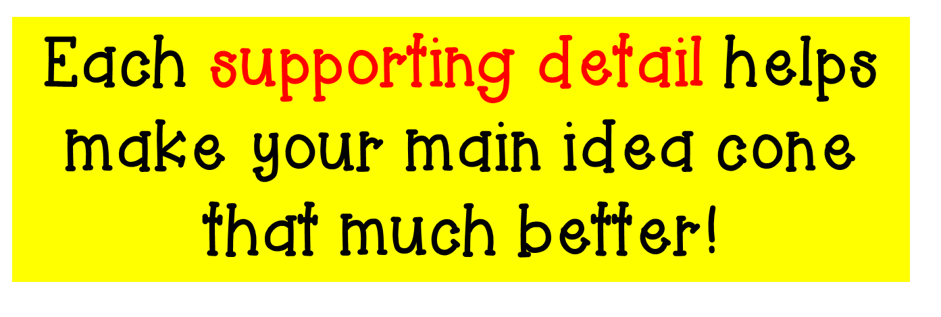

Slide 10
Each supporting detail
helps explain or prove
the main idea.

Slide 11
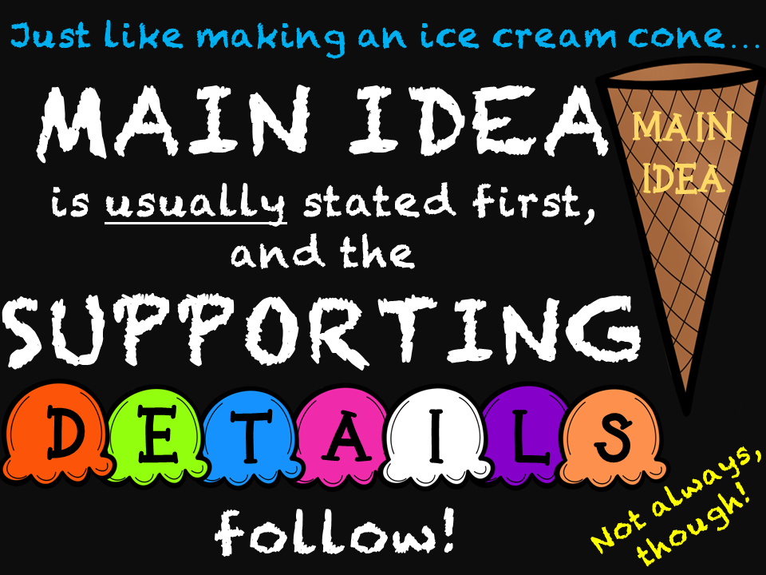

Slide 12
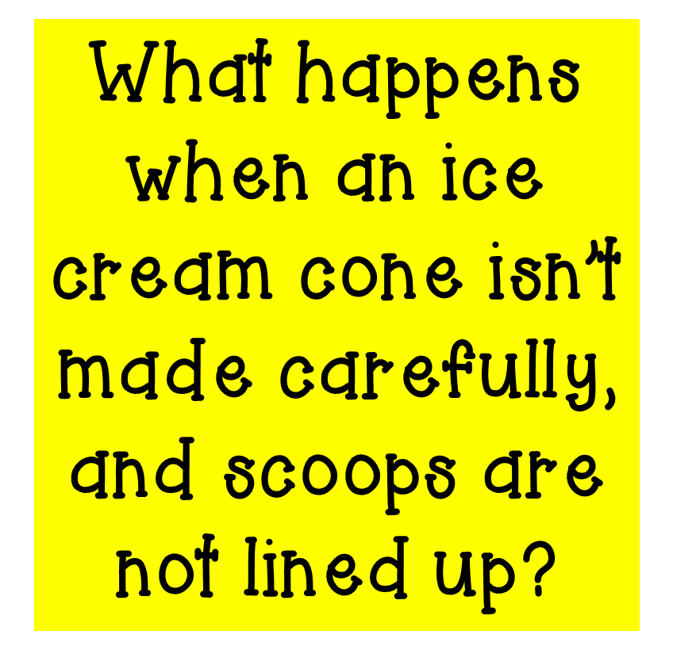

Slide 14
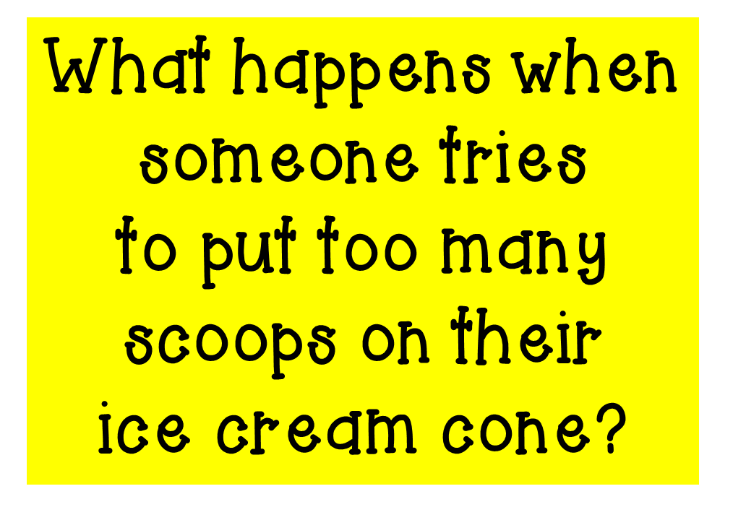

Slide 30
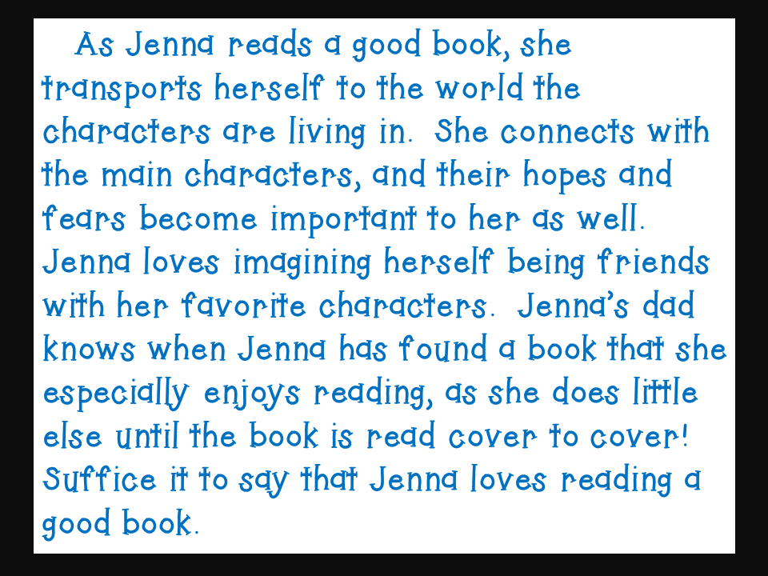

Slide 33
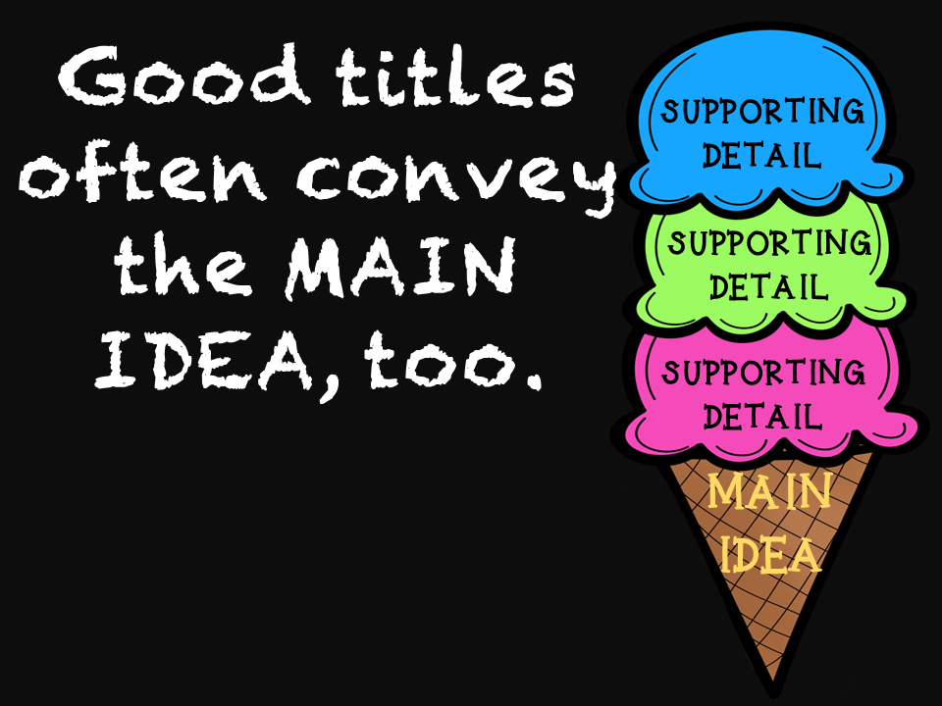

Slide 40
C. Fishing Bait: Options Galore

Slide 43
Let’s Review #1
I like to use the computer for many things. First, I like to play math games. Second, I like to write stories. Last, I enjoy watching videos. This is why I enjoy using the computer!

Slide 44
Let’s Review
What was the main idea?
A. The computer has many uses.
B. Watching videos is fun.
C. I want a new computer.
D. The Internet is huge

Slide 45
Let’s Review #2
After dinner my mom always serves dessert. Sometimes we have cookies. They are my favorite. Other times we go to Bruster’s and get some ice cream. Mint Chocolate Chip is the best. But other times, we get Grandma’s special Cannolis. No matter what, we always get some kind of dessert.

Slide 46
Let’s Review
What was the main idea?
Grandma makes good treats
Dessert is special
Desserts After Dinner
Cookies are a great dessert

Slide 47
Let’s Review #3
There are lots of fun things to do in Pittsburgh. First, you can go to one of the many museums. I enjoy the Science Center the most. Next, you could go to a Pirates, Steelers, or Penguins game. Finally, you can ride the incline and see the whole city from Mount Washington. You could have a lot of fun exploring this city!

Slide 48
Let’s Review
What is a supporting detail in that paragraph?

Slide 49
Let’s Review #4
Cupcakes are fantastic! A yellow, moist cake is easy to bite into over and over again. Fluffy and smooth icing sits on top of the mini cake. Sometimes, I dream about cupcakes with chocolate and strawberry icing. Where can I go get a cupcake?

Slide 50
Let’s Review
What is a supporting detail in that paragraph?

Slide 51
Let’s Review #5
Tony Hawk is a famous skate boarder. He got his first skateboard when he was 9! By age 12 he was sponsored, and by age 14 he was a professional. Today, he’s known for the skateboarding video game he helped to create called Pro Skater. Tony Hawk has accomplished a lot!

Slide 52
Let’s Review
What the main idea of the passage?

