Slide 1
Welcome to Sixth Grade Science
Mr. L. Mortimer
Objective: To familiarize families with the curriculum, policies, and procedures of sixth grade science.

Slide 2
Introduction to Physical Science
Chapter 1: The Nature of Science
What is Science
Science in Action
Models in Science
Chapter 2: Measurement
Description and Measurement
SI Units
Tables, Drawings and Graphs
Chapter 3: Atoms, Elements, and the Periodic Table
Structures of Matter
The Simplest Matter
Compounds and Mixtures

Slide 3
Chapter 4: States of Matter
Matter
Changes of State
Behavior of Fluids
Chapter 5: Matter Properties and Changes
Physical Properties
Chemical Properties
Physical and Chemical Changes
Chapter 10: Motion and Momentum
What is motion?
Acceleration
Momentum

Slide 4
Chapter 11: Forces and Newton’s Law
Newton’s First Law
Newton’s Second Law
Newton’s Third Law
Chapter 13: Energy and Energy Resources
What is energy?
Energy Transformations
Sources of Energy
Agricultural Science
Webquest

Slide 5
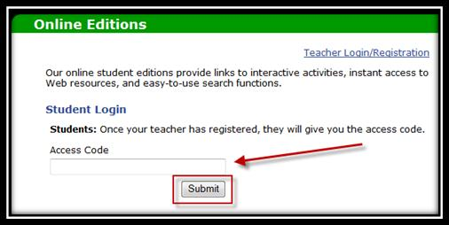
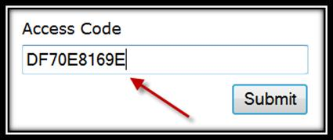
Online Textbook
Textbook can be accessed online F18BCD5F5B
Guide to Accessing Online Student Textbooks
Browse to the following website: http://www.glencoe.com/ose/index.html

Slide 6
Graded Items
Class Activities
Homework
Quizzes
Tests
Projects
* Extra credit may be built into various activities.

Slide 7
Grading Scale
90 – 100% = A
80 – 89% = B
70 – 79% = C
60 – 69% = D
59% or below = E
Accessing child’s grades

Slide 8
Assignment Book
Required to keep track of assignments
Given time during class
Communication

Slide 9
Absence Procedures
Upon return pick up missed work from assigned location
See me at anytime for assistance
Vacation Form
Obtain ahead of time to be considered legal absence
Parents fill out top portion
Student sees teachers for signatures & work
Parents sign form again/Student turns form in to office
Work must be completed before return to school

Slide 10
Homework Site
Students given notice of quizzes and tests
Study guide provided for tests
Assignments, quiz dates, and test dates can be found on my homework page.
www.northallegheny.org
* You may use Marshall’s homework site to access the page!

