Slide 1
High School Lifetime Activities
Structuring a Biking Program
PEP SUMMIT
February 17-19, 2012
San Antonio, TX

Slide 2
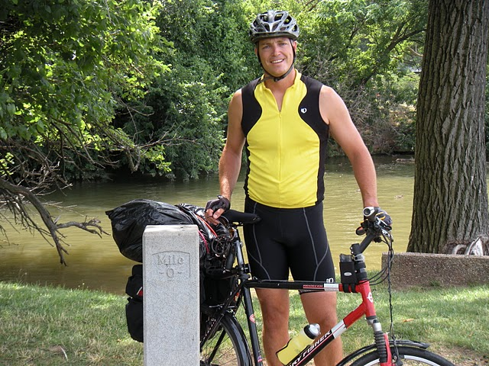
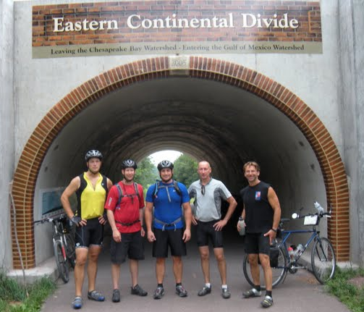
Being a Biker

Slide 3
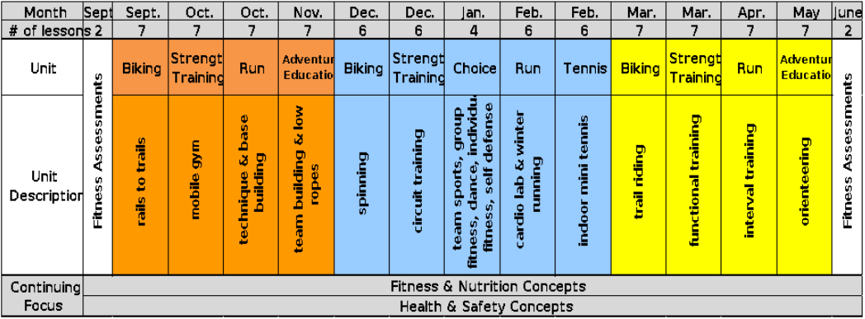
Individual Activities/Aerobic Fitness; Biking
Progressions: Unit 1 safety and rails to trails, Unit 2 spinning, Unit 3 single track trail riding, triathlon Equipment; bikes, helmets Training / Resources; other local schools, IMBA
Handouts; Bike inspection card, contract, group ride sheet

Slide 4
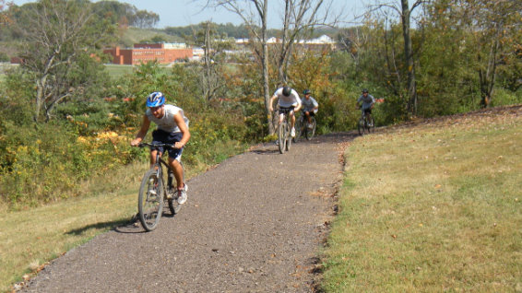
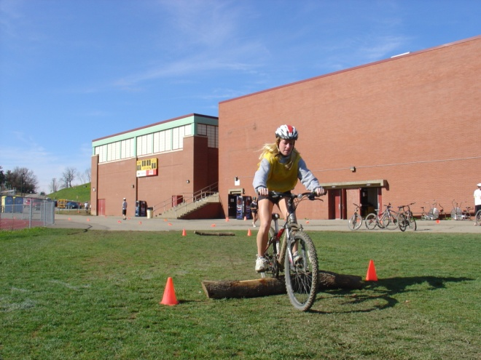
Biking
Biking 1, Fitness Biking / Rails to Trails
Unit Description: During the Fitness Biking Unit, students will improve their Cardiovascular and Muscle Endurance while learning the skill of biking as a lifetime activity. Students will be introduced to the benefits of biking, biking safety, rules of the road and biking maintenance. In addition, students will be introduced to the many local biking options available to them outside of the classroom including but not limited to the vast network of “Rails to Trails” in the Pittsburgh area.

Slide 5
NAI Mountain Biking Unit: Critical Elements
Important: The use of a mountain bike at NAI is a privilege and not a right. If you ride
recklessly or do not take care of the equipment you may loose this right without warning.
Safety and Injury Prevention
Helmets – Helmets must be worn at all times while riding. You may bring your own helmet from home or use one of ours. If using our helmets we encourage you to wear a bandana or cap between your head and the helmet.
Comfort Level – If you are uncomfortable during any part of a ride you should get off and walk your bike through that portion of the ride.
Bike Fitting – Never ride a bike that has a top tube height that you can not comfortably stand over. Adjust the seat height so that your knee is almost straight at the bottom of each pedal stroke, adjust it slightly lower if you plan on riding over bumpy or difficult terrain.
ABC Quick Check – You must perform a complete safety check before every ride. You can never be sure that the previous rider left the bike in safe working order.
A = Air: Check the tire pressure it must be between 60 and 65 psi. If the sidewall can be squeezed the tire needs inflated.
B = Brakes: Check that the front and rear brakes are working properly while walking beside the bike.
C = Cranks and Chain: Check that the cranks and chain are working properly by using your hand to pedal backward. The pedals and chain should move freely, if not oil them.
Quick: Check both wheels to see that they spin true and are securely fastened.
Check: Check that the bike shifts properly by taking a short ride on the paved area behind the building.

Slide 6
NAI Mountain Biking Unit: Critical Elements
Safety
Opting in: The class will be given a basic set of challenges using a challenge by choice format. You may opt in to increasingly difficult challenges as your comfort / experience allow.
Handling Skills
Shifting Gears – Remember to shift early and often. Anticipate the need to shift and when you shift peddle lightly. You will loose your riding privileges for grinding the gears.
Riding Position – Keep your upper body steady and loose while the bike moves beneath you. Ride with you elbows and knees flexed. On bumpy trails keep your butt off the saddle slightly.
Braking – Never jam on the brakes, brake gently using 60% front brake and 40% rear.
Turning – In slow speed turns, turn the handlebars. In higher speed turns use more body lean, press down on the handlebar with your inside hand, and keep the cranks horizontal.
Climbing – Shift early into a lower gear than you think you will need. Keep your weight centered over the bike with your chest down to keep weight on the back wheel.
Descending – Shift into the large chain ring on the front. Keep your weight back with your arms extended to unweight the front wheel so that it will roll easily over obstacles.
Track Stand – Coming to a stop and keeping the bike balanced without putting a foot down. Keep pressure on the front pedal with the brakes applied and the wheel turned slightly.
Rolling over objects – Approach the object at a 90 degree angle while maintaining momentum. As you approach the object pull up on the front wheel to lift it over the object while you continue to pedal as the rear wheel rolls over the obstacle.

Slide 7
NAI Mountain Biking Unit: Critical Elements
Operating Environment
Trails – Respect nature and take all trash back out with you.
Ride only on open trails and do not trespass.
Control your bike at all times and space out on hills.
Bring along a spare tube, pump, and tools. Nothing spoils a good ride more than hiking out of the trail carrying your broken bike.
Yield the right of way to all other trial users. People will judge all cyclists by my actions.
Assume there is an obstacle around every bend. Even on trails you know there could be a hiker, animal, or fallen tree.
Roads – Cyclists have the same right and obligations when riding on the roads as do motorists. Cyclists are subject to fines for disobeying the same laws as motorists.
Don’t assume that motorists see you. They may be on the phone or changing radio stations.
Stop at all marked intersections and look for oncoming traffic.
Ride single file.
Before making a turn first check for traffic in all directions and then single the turn by pointing in the direction you are turning using your arm on the side you are turning to.
If you see and obstacle on the road point to it and yell to riders who are following.
When slowing or stopping put your left arm out with your palm facing the riders behind you and call out stopping or slowing.
When passing call out passing left, make sure you are not cutting off another rider and only pass on the left.
When a car is approaching from ahead or behind call out car up or car back then pass it up or back the line.

Slide 8
NAI Mountain Biking Unit: Critical Elements
Maintenance
Tire Inflation – Inflate the tires using the larger of the two holes on our pumps. After placing the pump on the valve open the lever to a position perpendicular to the pump hose to lock the pump on the valve. Inflate the tires to 60 psi to reduce the risk of a flat tire.
Chain – If the chain is making noise or binding peddle the cranks backward while applying lubricant.
Brakes – If the brakes are loose use the barrel adjuster on the brake levers to increase the tension.
Seat Height – Adjust the seat height before each ride. While standing next to the bike the seat should be at the mid hip.
Professional Maintenance – 2x per year we have the local bike shop come out to do safety check and perform routine maintenance on top of our regular checks.
Access
Where to ride and who to ride with - Use the following web sites to find places to ride and people to ride with around Pittsburgh.
http://bike-pgh.org/ http://www.bikepittsburgh.com http://pittsburgh.about.com/cs/biketrails/ http://www.atatrail.org/ http://www.pittsburghmountainbiking.com/ http://www.porcmtbclub.org/ http://www.ptagtrails.org/
Health Benefits
Mountain biking: can be enjoyed alone or with friends throughout your lifetime, is a great alternative aerobic exercise to running, is a great way to sightsee or enjoy nature.

Slide 9
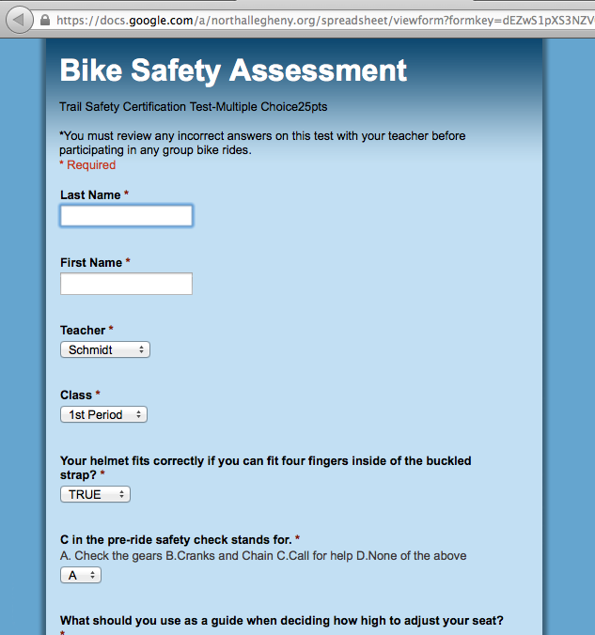
The Flipped Lesson

Slide 10
Check In Cards
back
front

Slide 11
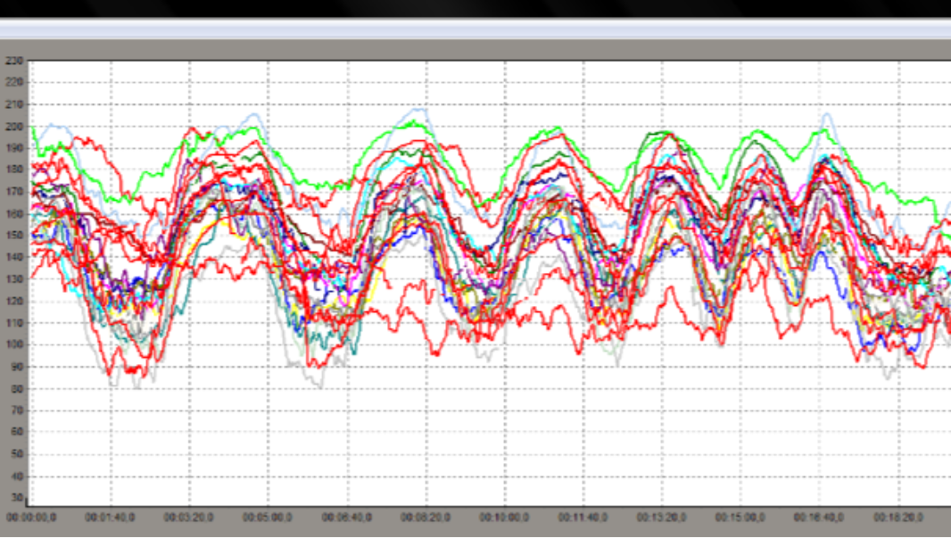
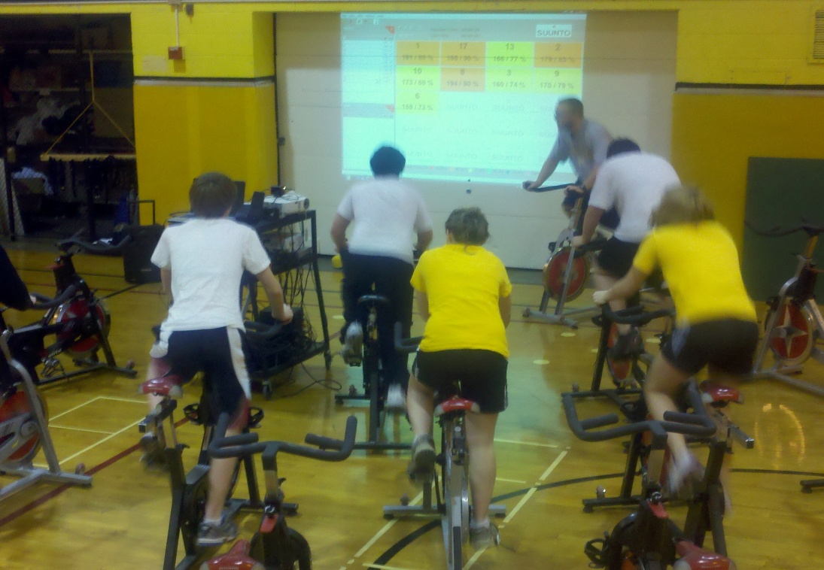
Biking 2 Spinning
Unit Description: Building on the benefits of Fitness Biking, the spinning unit will introduce the students to an alternative biking activity for inclement weather.
Which students are meeting objectives? Just spot check ones you suspect are not getting it done or hold up positive examples.

Slide 12
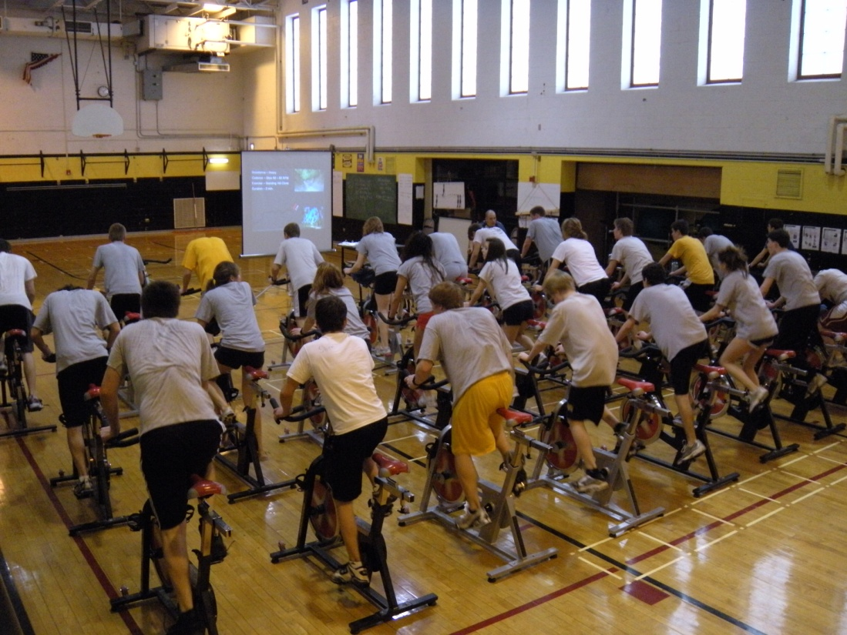
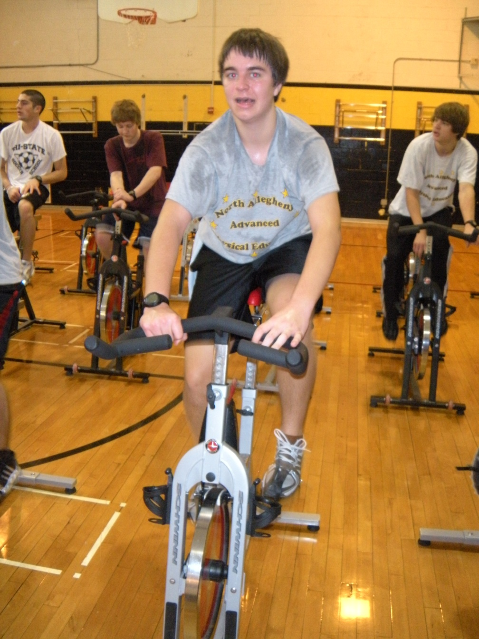
Spinning
We use spinning to simulate local rides in addition to traditional spin workouts.
Pittsburgh Dirty Dozen
DC to Pittsburgh Trail
local trail ride videos
thesufferfest.com
Spinning.com

Slide 13
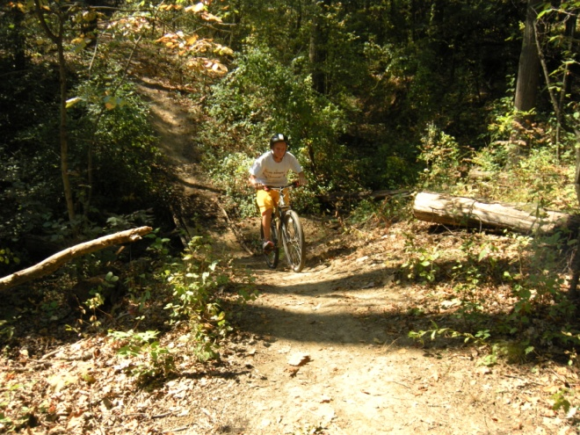
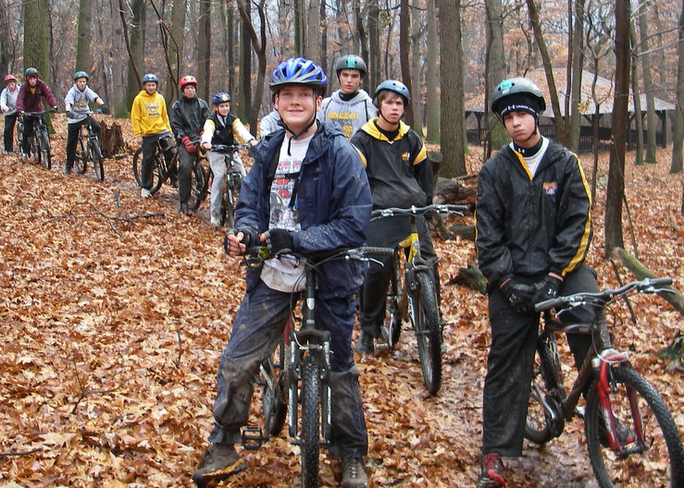
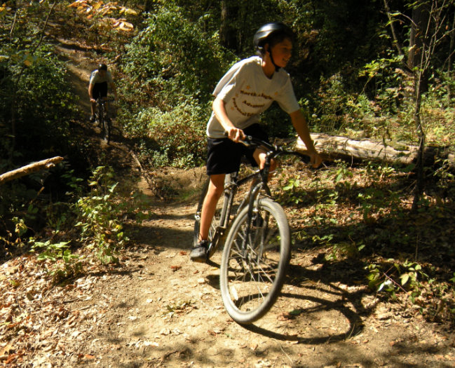
Biking 3 Trail Riding
Unit Description: As a culmination to the Biking track, Mountain Biking / Trail Riding will give the students the opportunity to get outside the traditional physical education environment and into a realistic setting for biking as a lifetime activity. Students will have the opportunity to ride throughout NAI’s network of trails while continuing to enhance their fitness levels. Grouped according to ability levels, students will work independently and as part of a team to experience the benefits of Mountain and Trail Biking as a lifetime activity.

Slide 14
Trail Riding Groups

Slide 15
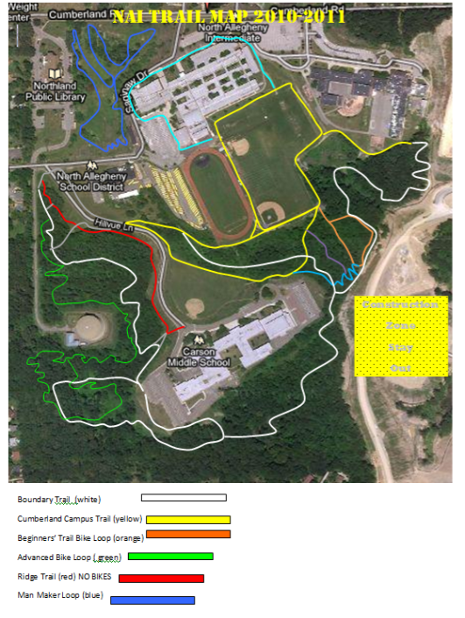
Riding Options
We have created a system of interconected trails at our Cumberland Campus to provide variety during our running and biking units.
Biking trails in small groups improves the students experience through differentiating the challenge and providing a social aspect.
We keep kids accountable through the use of heart rate monitors and biking with them.

Slide 16
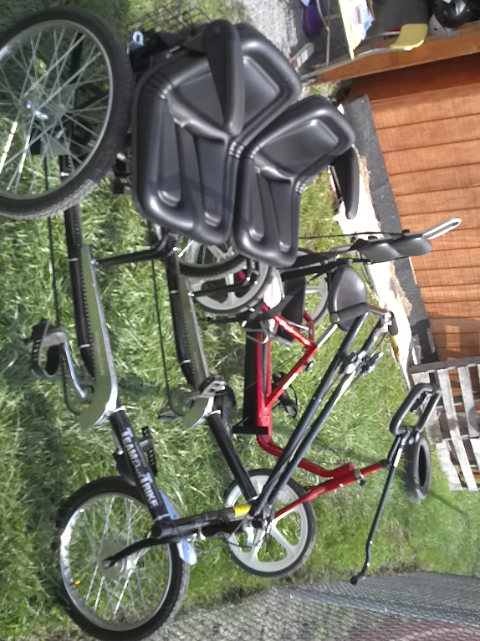
Adapted Biking

Slide 17
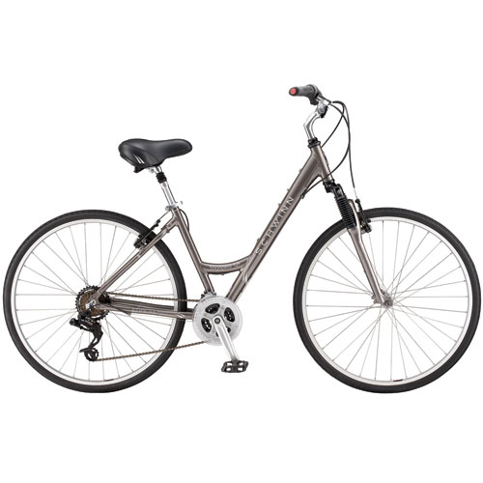
Beginners

Slide 18
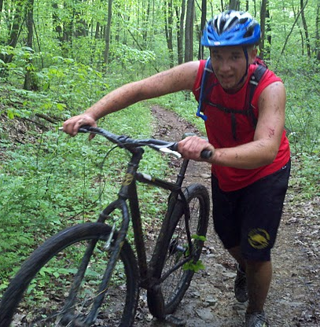
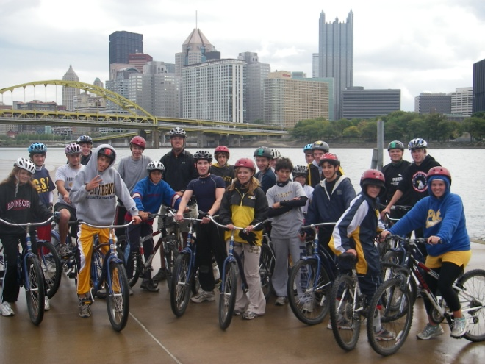
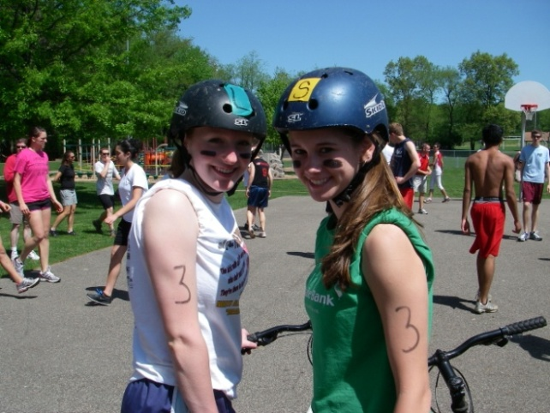
Field Trips
Adventure Racing Trips
Touring Trips

Slide 19
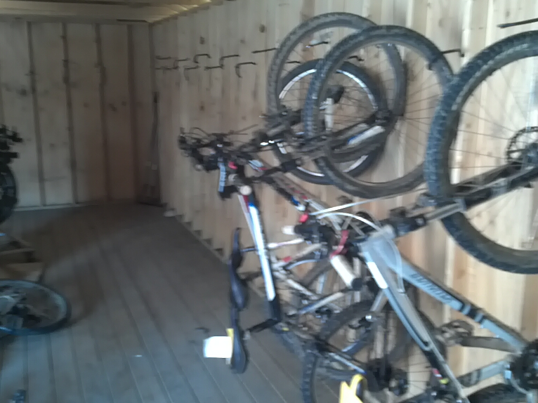
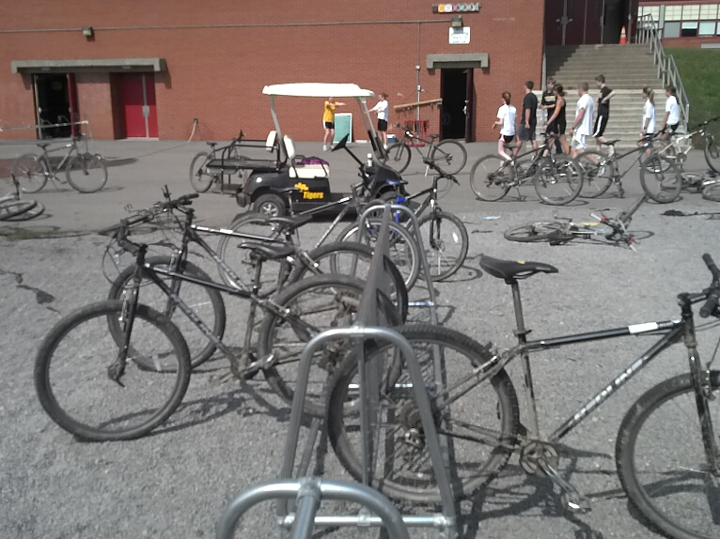
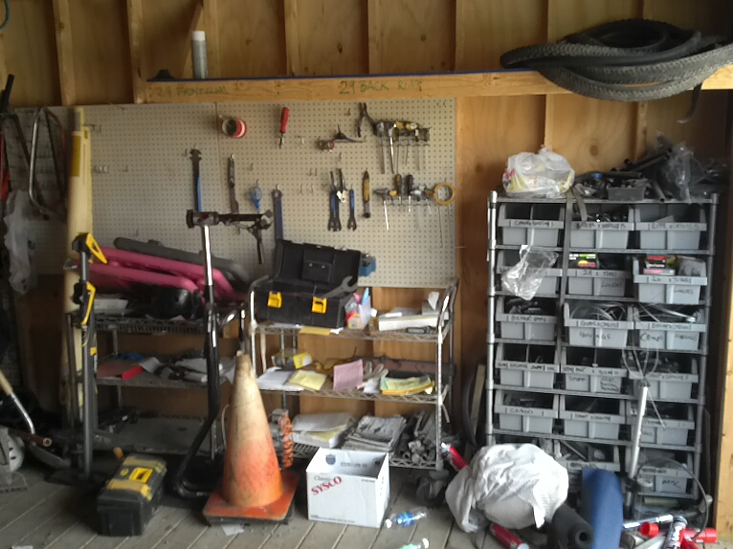
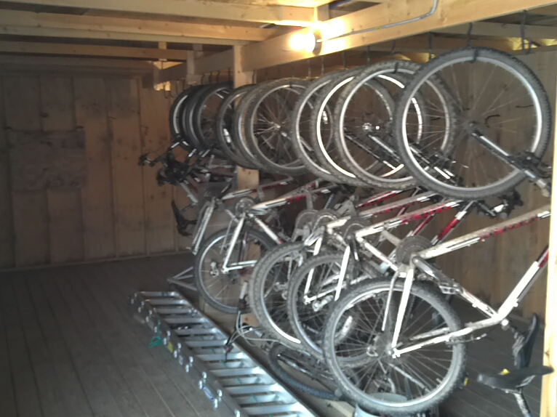
Facilities and Storage

Slide 20
Thank you for listening
dschmidt@northallegheny.org
www.northallegheny.org
http://www.northallegheny.org/page/7089

