Slide 1
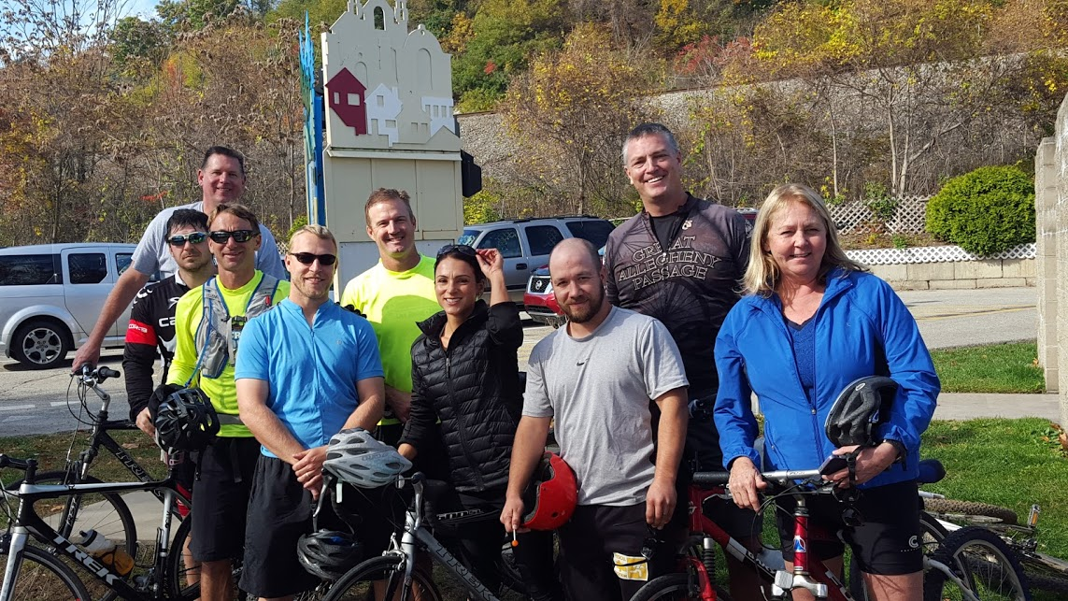
Quality Physical Education in Schools
January 20, 2016
“If we could give every individual the right amount of nourishment and exercise, not too little and not too much, we would have found the safest way to health.”
~ Hippocrates

Slide 2
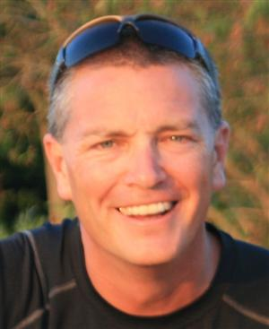
Who am I?
David Schmidt
B.S. from Indiana University of Pennsylvania, Master's degree from Slippery Rock University
Physical Educator and coach in the North Allegheny School District for 23 years.
K-12 Department Chair for 14 years, directed a change from traditional to the New PE.
Vice President of Physical Education for PSAHPERD
2015 Keystone Technology Star
2005 Secondary Physical Education Teacher of the year from Pennsylvania State AAHPERD.
2008 PEP Grant winner.
North Allegheny Intermediate High School is recognized as a statewide model program.
Presented at local, State, and National conferences along with hosting numerous visitations for schools from around Pennsylvania.
Past local Allegheny County AHPERD President.

Slide 3
What is your role?
(Choose one)
_____ High School Teacher
_____ Middle School Teacher
_____ Elementary Teacher
_____ Department Leader
_____ Administrator
_____ Advocate
(Please respond to poll question in your WebEx control panel)
2015 Pennsylvania PE TOYS

Slide 4
Topics will include;
Why is Quality Physical Education so important for students and for our society in general.
Defining the mission of your program.
Practical hands on examples of quality Physical Education Programs and ways you can begin to make changes in your program.
Key steps to increase support for PE in your school.
Resources to develop your program.

Slide 5
Why is Quality Physical Education so important for students and for our society in general.

Slide 6
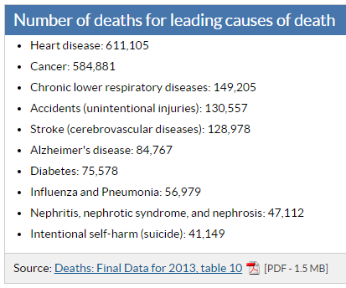
Why is Quality Physical Education so Important
WE HAVE AN EPEDEMIC OF CHRONIC DISEASE!
The Surgeon General says to prevent chronic disease and improve quality of life, society needs to:
Eat Better, Move More, Control Stress, and Sleep Better
Medicine will not cure this, they will treat it. Prevention is key.
For children and youth the #1 place prevention can be accomplished is in schools.

Slide 7
Why is Quality Physical Education so Important?
In our society we lead a life where convenience is a top priority instead of health.
We need to put our students on a path to lifetime wellness.
We can do this by teaching WHY and HOW?

Slide 8
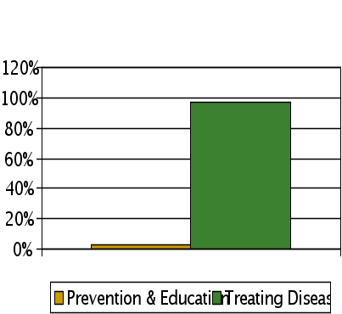
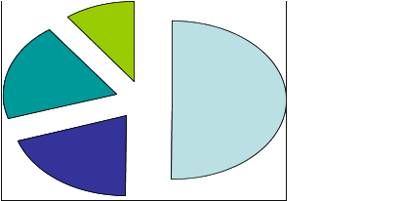
What I’ve Learned
Travels and visitations from our PEP Grant and North Allegheny curriculum review process have helped me to learn this basic truth
Passionate leaders make the difference: You can be that leader!
$2.9 Trillion Spent on Health Care in 2013
Factors Affecting Health Status
Prevention 7% vs. Treatment 93%
- $$ is not the solution. You are! -
“He who cures a disease may be the skill fullest, but he that prevents it is the safest physician.” ~ Thomas Fuller

Slide 9
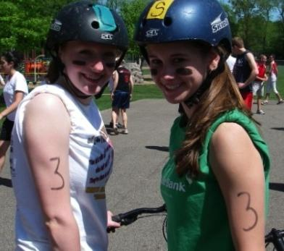
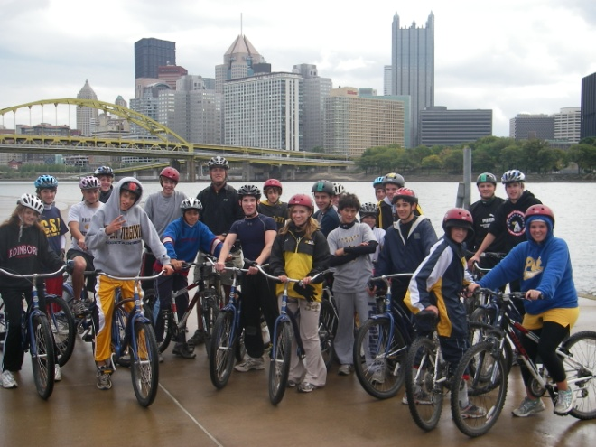
What is the #1 Goal
“Lack of activity destroys the good condition of every human being, while movement and methodical physical exercise save it and preserve it.” ~ Plato
The mission of the “New PE” is to “guide youngsters in the process of becoming physically active for a lifetime.”
-George Graham, Past-President of NASPE
Physical Education is the only subject that by its very nature can affect how you feel every day for the rest of your life!
“Our job is to help students to find their personal path to wellness.”
- Dr. Randy Nichols

Slide 10
Why is PE Important?
People need to understand;
Health related fitness impacts our personal quality of life. (star athlete example)
Our health impacts our whole society.
Our level of fitness has changed, can change, and will change based on our actions, NOW is the time to take control of our lives.

Slide 11
Defining the mission of your program.

Slide 12
Belief and Mission
Belief Statement
I Believe that all people are happier and better able to meet their life goals when they are healthy and strong.
I see Physical Education as a way of facilitating students to maximize their quality of life by empowering them to have the health, fitness, and skills to do what they want when they want.
Mission Statement
I want to work with my students to provide them with successful experiences related to health, exercise, activity, and a love of the outdoors so that they will be intrinsically motivated to pursue an active and healthy lifestyle. I will carefully plan my lessons to maximize the amount of time students are engaged in moderate to vigorous physical activity. I will do this to empower children so they can feel a sense of personal accomplishment as they work with others to accomplish their goals and be responsible for their own futures.

Slide 13
Program Guiding Objectives:
All students will be lifelong learners, to facilitate this I need to address why each curriculum unit is presented and how to extend participation beyond the class.
All curriculum units I present will be lifetime in nature and emphasis physical fitness.
I will attempt to expose students to many different activities. Every student may not enjoy every activity but if each student finds a few activities to participate in for a lifetime I have accomplished my number one goal.

Slide 14
VIEWPOINTS
This is what we “GET TO DO” vs. what we “HAVE TO DO”
Creating an attitude
Others perspectives; we need to educate more than our students.
Parents, Administrators, and other Teachers
Who is out biggest problem? Are we our own worst enemy?
Questioning Phil
“The quality of a person's life is in direct proportion to their commitment to excellence, regardless of their chosen field of endeavor.” - Vince Lombardi

Slide 15
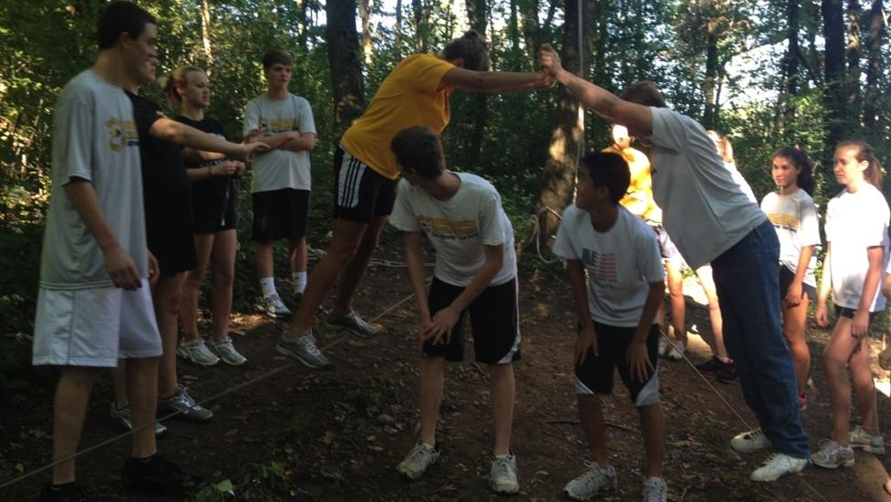
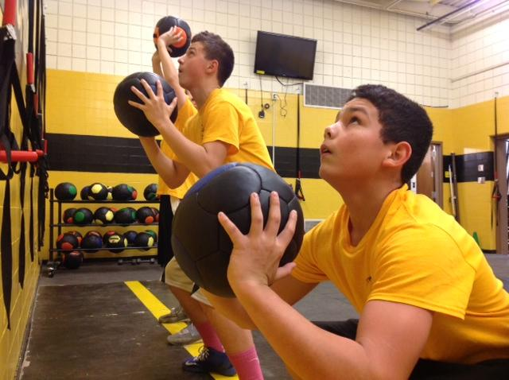
Stretching Ourselves
90% of learning occurs in the stretch zone
In traditional physical Education most students are either in their comfort zone or panic zone.
If you expect kids to stretch themselves you must lead by example.
(Project Adventure)
This is what we
“GET TO DO”!

Slide 16
Key steps to increase support for PE in your school.

Slide 17
Key steps to increase support
#1 provide a quality program. Your students can and should be your best advocates.
Start with why.
Give students what they need, that may not always be what they want at the moment.

Slide 18
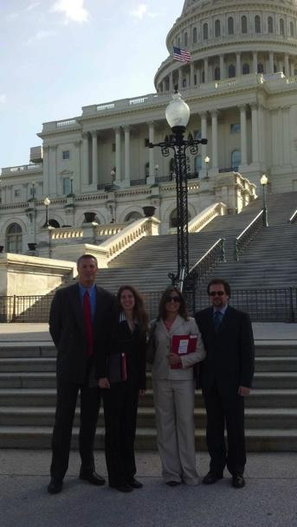
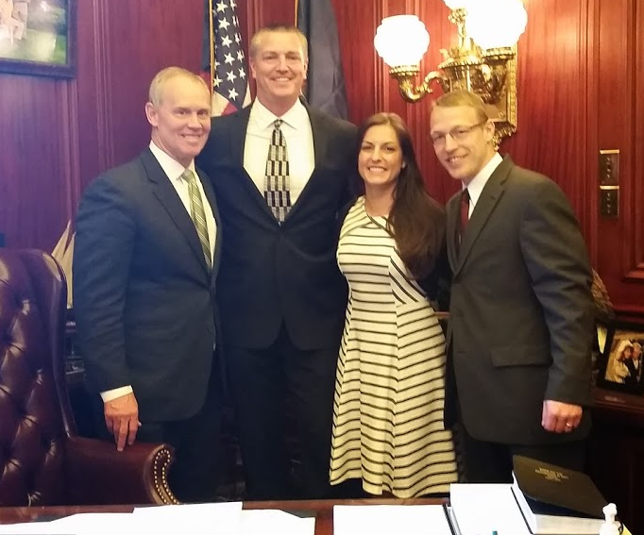
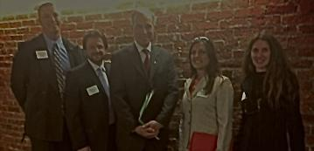
What Can You Add?
PASSION: Share with your students why fitness and the activities that you teach are important in everyday life through example and stories
INITIATIVE: Do not listen to those who say no! Change what you have control over, your class (principals example 15%, 80%, 5%)
CONNECT: Get involved, SHAPE America, PSAHPERD, Action for Healthy Kids
Be a Role Model: Practice what you preach, you don’t have to be the best.
Partnerships: business, other schools, university (win / win)
Notes:
Dave

Slide 19
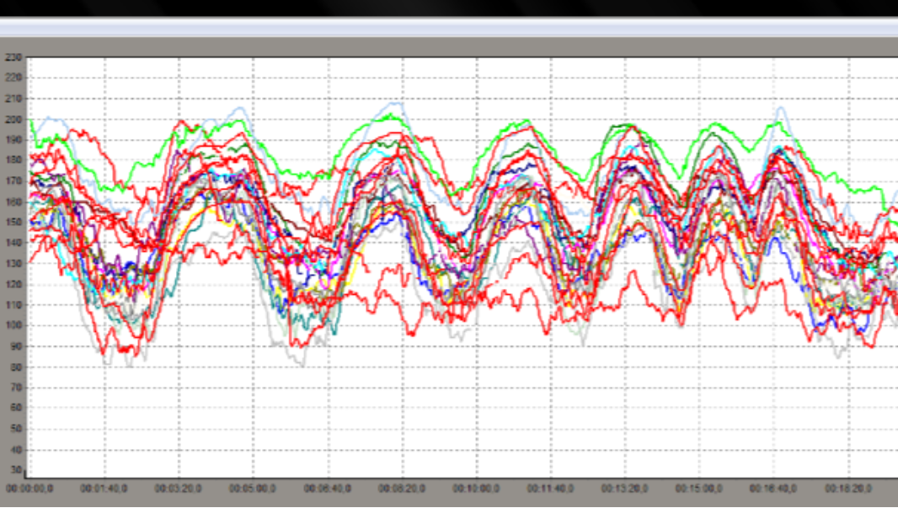
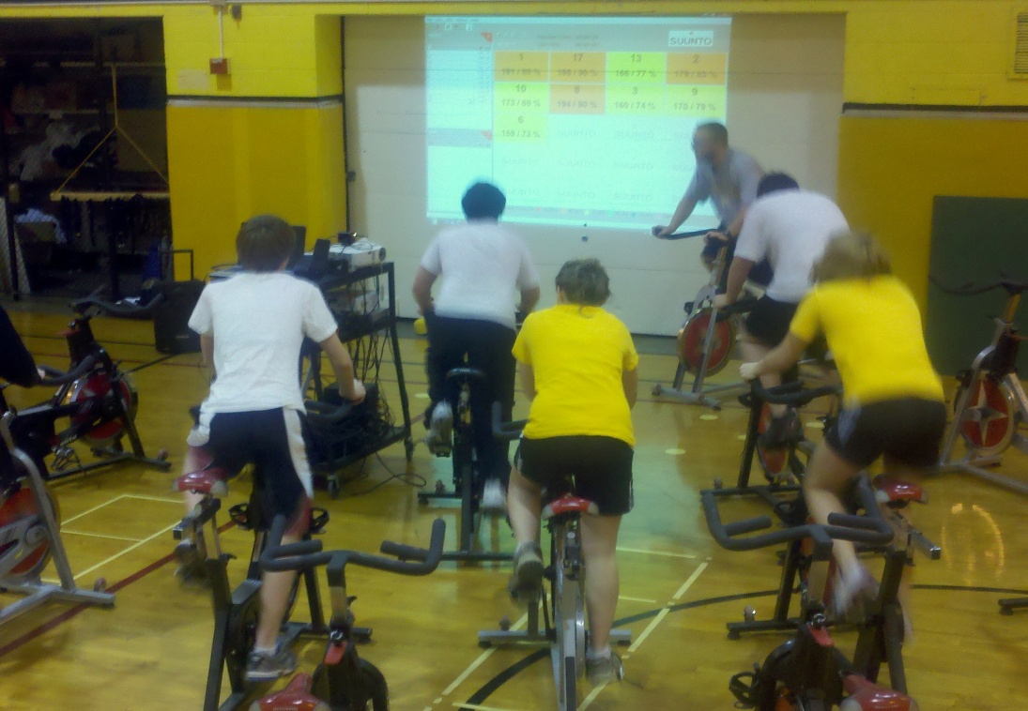
Grading in Physical Education
Use grading to lend increased credibility to your program.
Every student has the opportunity to earn a 100% regardless of their physical ability.
Grading on practical life skills and meeting course objectives vs. trivia facts and sport skills tests.
Which students are meeting objectives?
Notes:
Dave

Slide 20
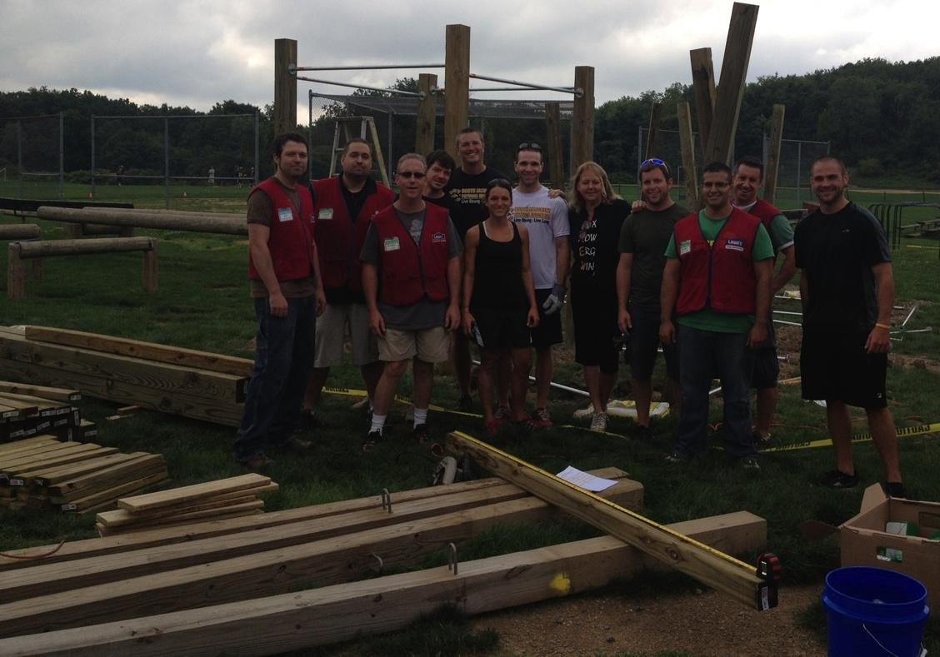
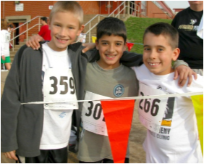
Funding
PEP Grant
Fund Raiser Runs; District wide 5k, 1mile, 1/2 mile, and fun runs.
Clothing Sales (T's, sweats, hats, gloves) Share your brand, send a message
Local Grants; Highmark, Lowes
Notes:
Dave

Slide 21
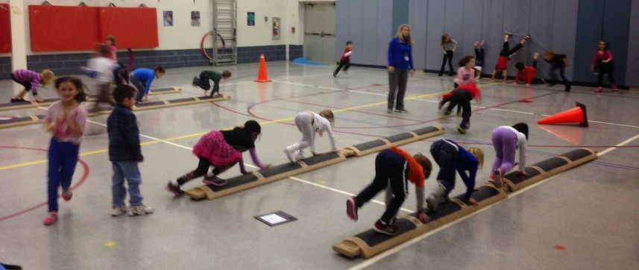
Practical hands on examples of quality Physical Education Programs and ways you can begin to make changes in your program.

Slide 22
Why lifetime activities and fitness?
Team sports are a sometimes thing that we should do after we develop our foundation of fitness and lifetime activities.
Lifetime activities by their very nature; are suited for a lifetime, can be participated in alone or with friends, and can be competitive or cooperative in nature. (biking to Niagara)
Only 3 percent of all Americans play a team sport regularly beyond age 25. The number is barely a fraction of that by the time people reach 45. (Dr. Robert Pangrazi, Arizona State University)

Slide 23
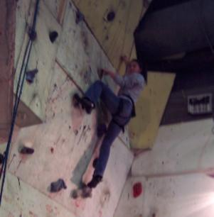
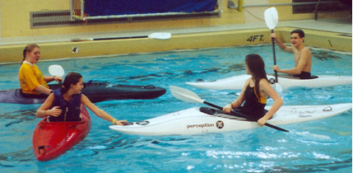
How do you start to change
How did you get the change started?
Start with your own classes. Don’t be afraid to try new things as long as they align with recognized standards and best practices.
Expand to a small core group. Let them influence others through leading by example.

Slide 24
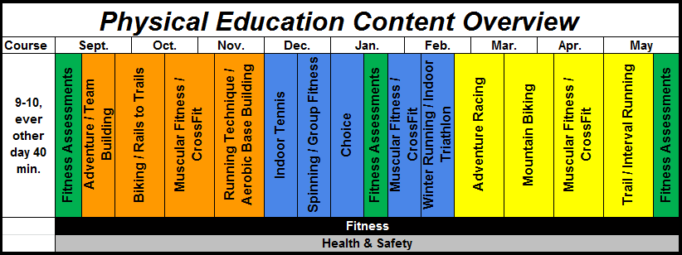
PE Curriculum Outline
Each unit is repeated in the fall, winter, and spring. This allows for seasonal variations
Notes:
Focus on 3 tier curriculum model; one for each season that builds on previous experiences

Slide 25
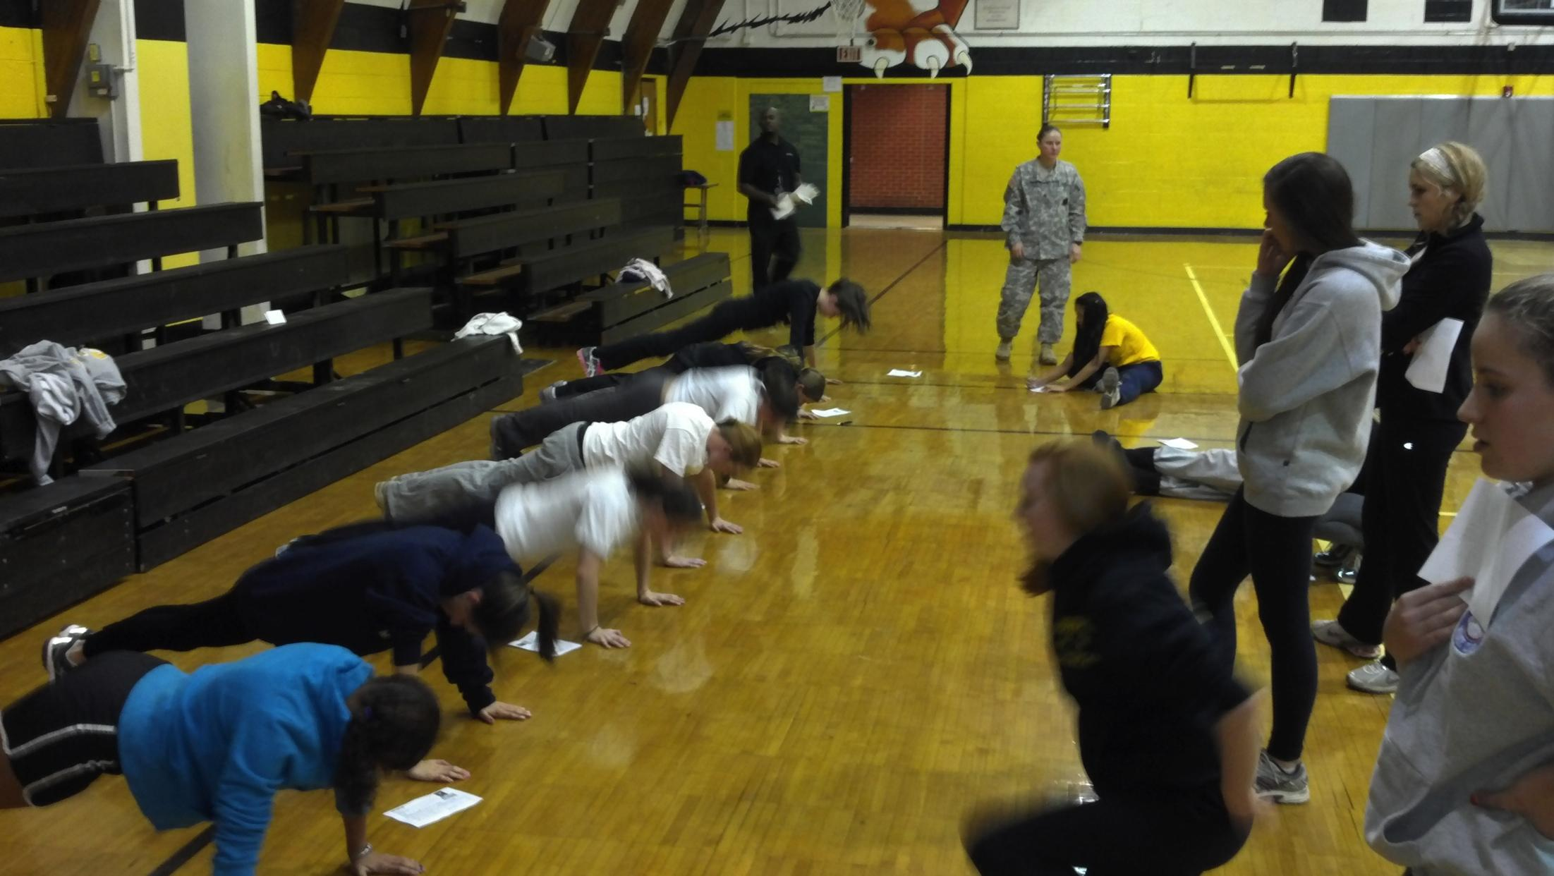
Fitness Assessment & Goal Setting
Students complete entry level, formative, and summative evaluations during each year.
Grades for this unit are based on students accurately completing each of the FitnessGram assessments based on objective standards, NEVER ON REPS OR TIME.

Slide 26
Why CrossFit?
How did we arrive at using CrossFit as our preferred method of teaching muscular fitness?
Is traditional selectorized strength equipment what is best for students?
Is it regularly accessible?
Is it functional? do our muscles usually work in isolation?
Not classroom friendly. Can you teach and supervise 30 different stations adequately?
It is a ball and chain to a gym!
One machine costs between $1,500 to $4,000 dollars. How much would that buy of the following; med balls, jump ropes, resistance bands
Provides for a maximum number of teachable moments.
Reproduces real life skills. Helps you to improve your “Quality of Life”
Helps produce an educated consumer who understands and can evaluate new fitness trends.
Encourages students to work together as they support and critique each other.
More bang for your buck!

Slide 27
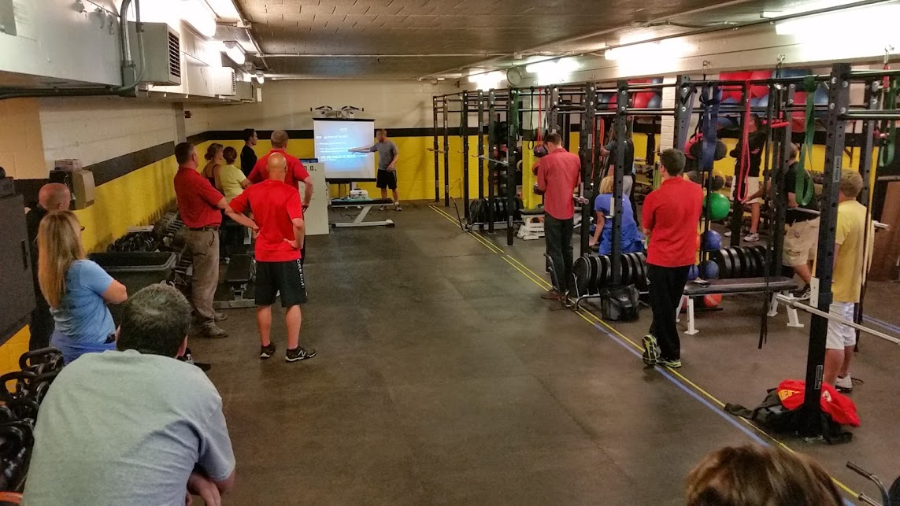
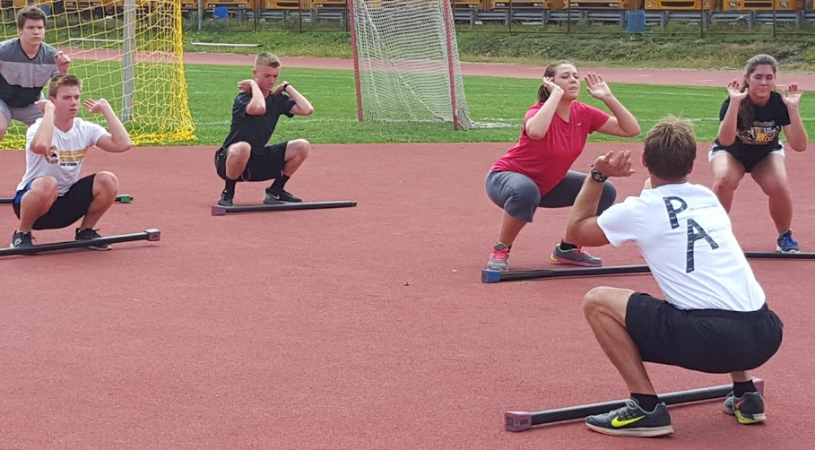
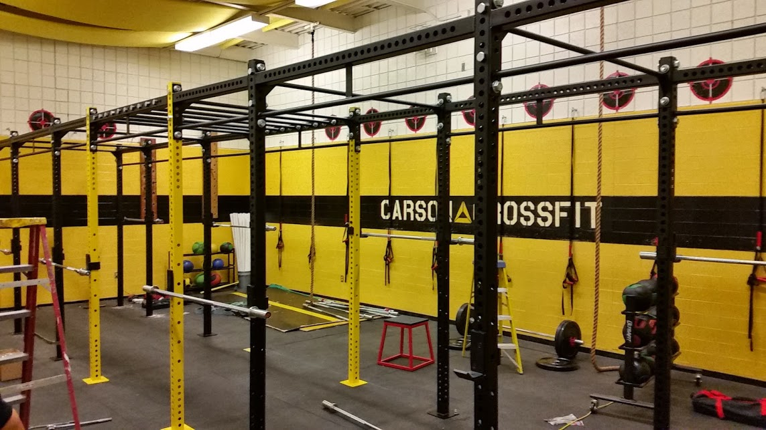
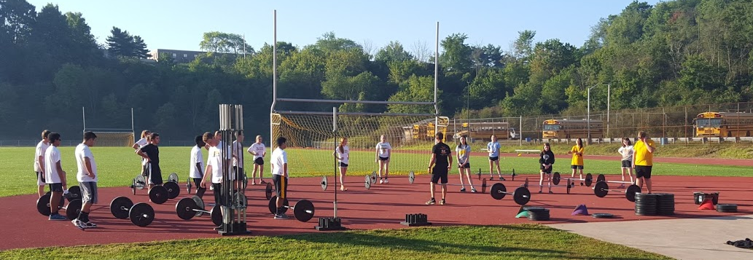
Why CrossFit?
More bang for your buck!

Slide 28
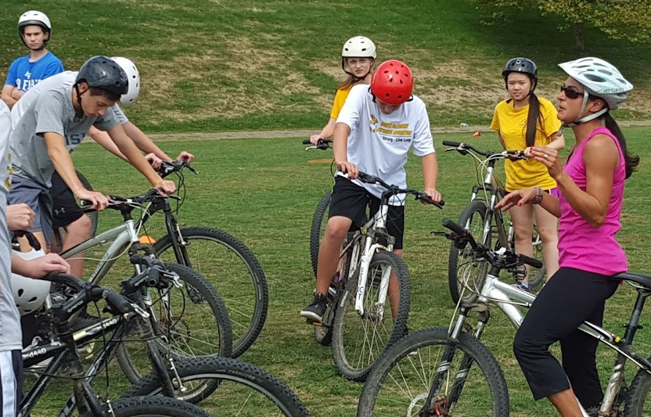
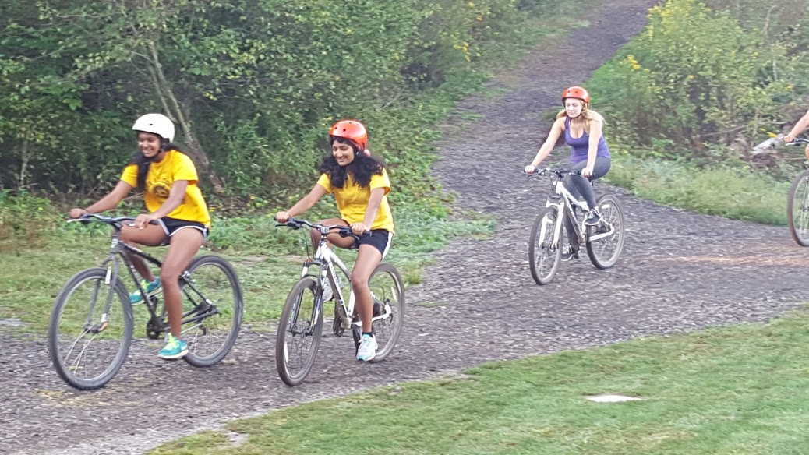
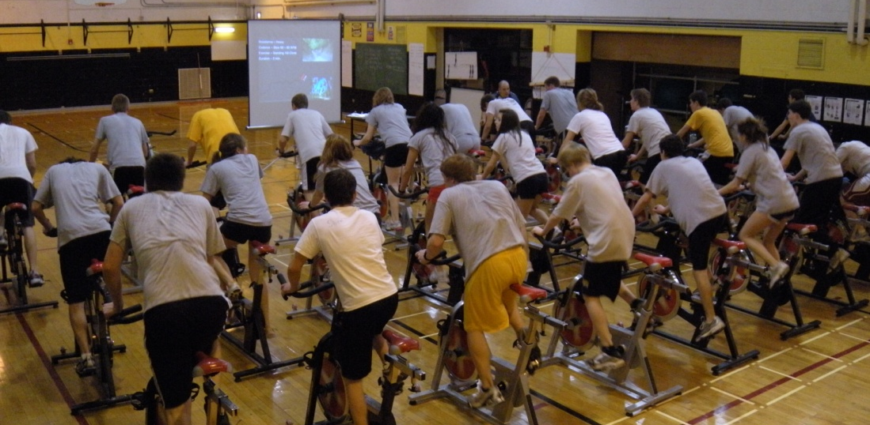
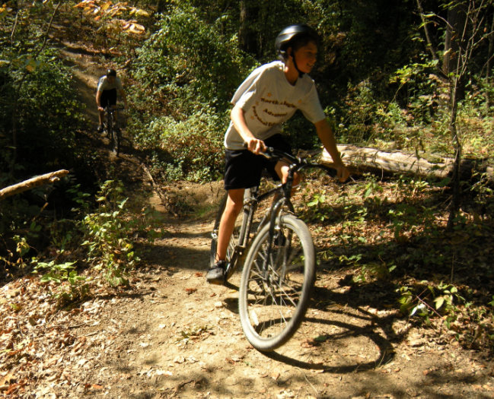
Why Bike?
Bike safety / rules of the road
Rails to trails
Where to ride
Mountain biking
Spinning

Slide 29
Why Running / Aerobic Fitness?
Running technique / injury prevention
Base building / heart rate training
Social running
Exercising in cold weather
Indoor training
Interval training
Trail running
Running technology
But isn’t PE supposed to be fun?
Sense of satisfaction vs. goofing around fun.

Slide 30
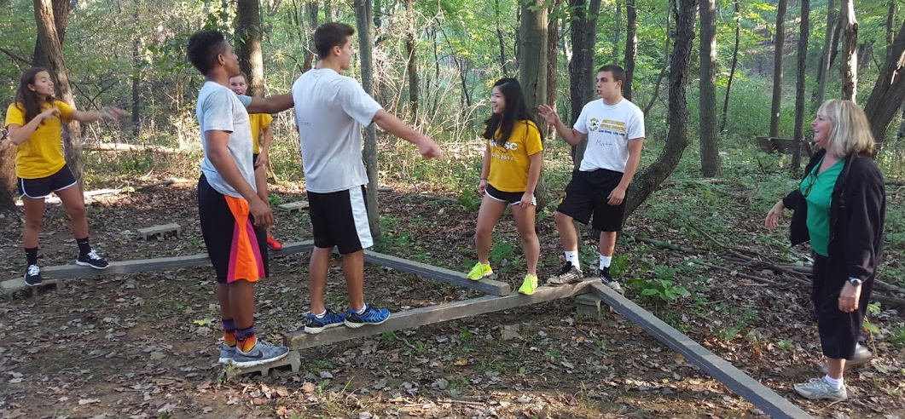
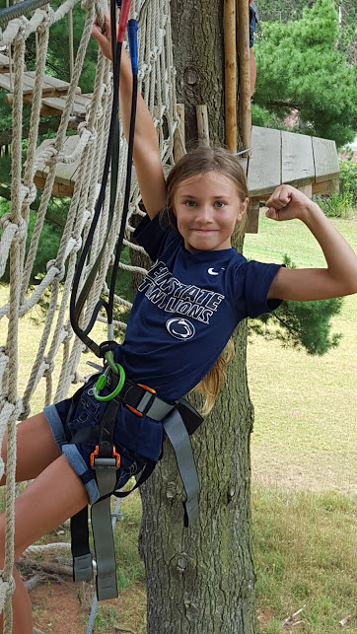
Why Adventure Education / Team Building?
Get to know students personalities
Teach about the value of different personality types
Great way to start the year and have students get to know each other
Problem solving

Slide 31
Why Indoor Tennis?
Accessibility and lifetime nature of sport
Progression from Pickleball in MS to Tennis in HS
Continuing growth in popularity of these activities and local access.

Slide 32
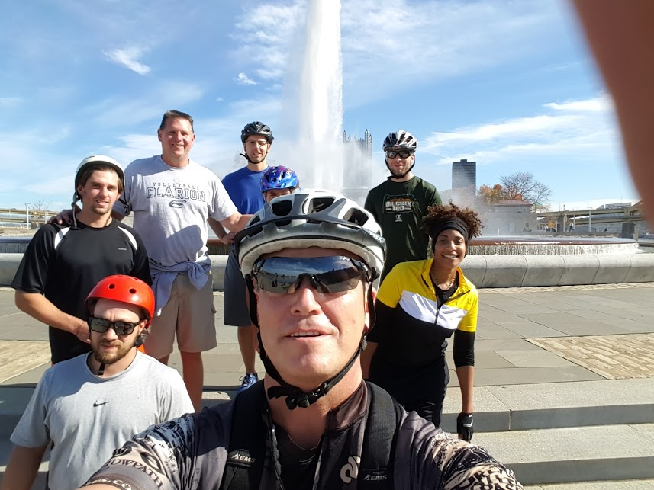
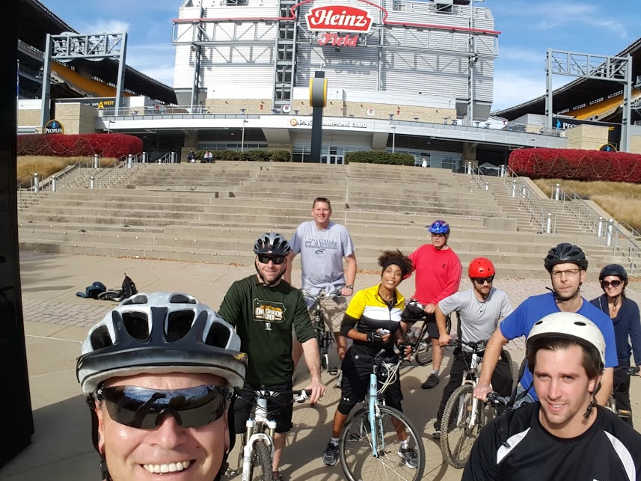
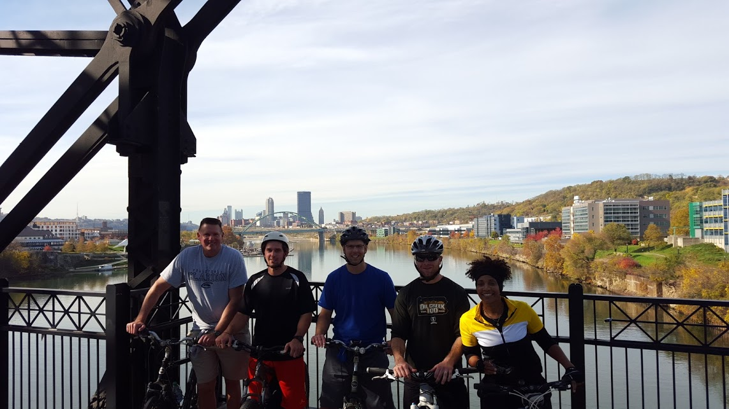
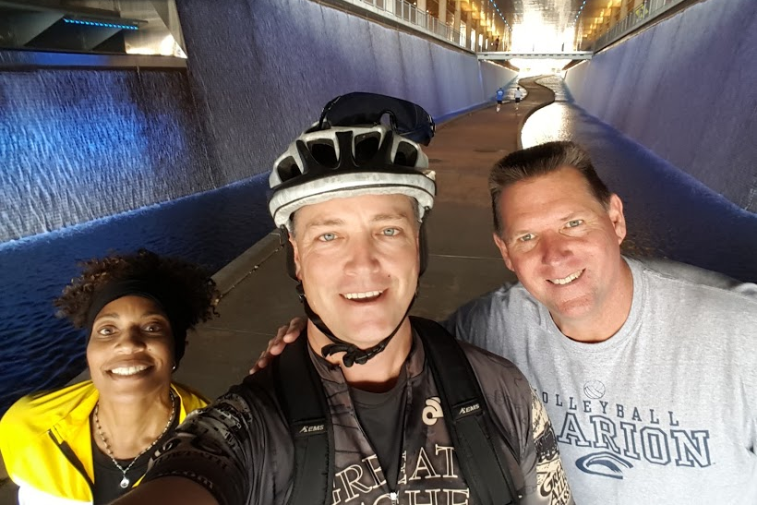
Why Adventure Racing?
It is a fun way to encourage fitness and training
Availability: a lot of different types of races around that meet the desires of various types of people
Make your own adventure
Selfie scavenger hunt
Geocaching

Slide 33
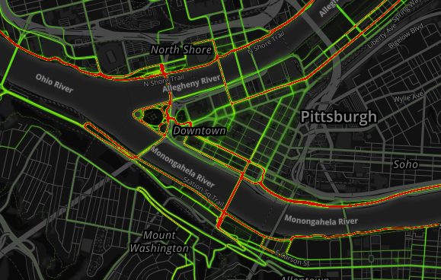
Enhancing PE Through Technology
Fitness and activity apps
Strava
Strava heatmaps
Google and Screencastify
Extension assignments; running, biking
Class Make Ups

Slide 34
Resources to develop your program.

Slide 35
Resources to develop your program
PSAHPERD / SHAPE America: get involved
Crossfit / Crossfit Kids
Pose running
Nutrition - nutritionfacts.org
Podcasts
My other curriculum presentations

Slide 36
Thank you for listening
dschmidt@northallegheny.org
www.northallegheny.org

